Slide 1
COGNITIVE TECHNOLOGY
FROM,
ERAJA GANAPATHY M
DIVYA R
DEPARTMENT OF CSE
KONGU ENGINEERING COLLEGE

Slide 2
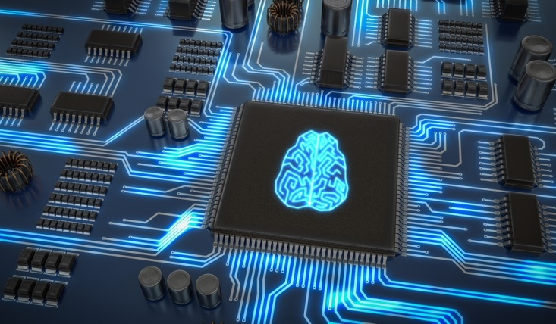
Synopsis
Introduction
Cognitive Technology and AI
Cognitive Computing
Cognitive Architecture
Cognitive Science
Cognitive Network
Natural Language Processing
Conclusion

Slide 3
Introduction
Mimics functions of human brain
Subset of AI
IBM’s Watson supercomputer
Business sector like Netflix

Slide 4
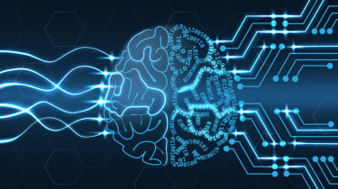
Cognitive Technology and AI
Cognitive Technology
Artificial Intelligence
Mimicking human behaviour and reasoning to solve complex problems.
Replicate how humans would solve problems
Accurately reﬂecting reality and providing accurate results to solve complex problems.
Solve problems that can potentially be better than humans

Slide 5
Cognitive Computing
Solve complex problems characterized by uncertainty and ambiguity
Conflicting data and suggest an answer that best fits the situation
Accurately modelling how the human mind senses, reasons and responds to stimuli around it

Slide 6
Cognitive Architecture
Hypothesis inspired by the human mind
Development of artificial agents
Integrate intelligence and capabilities from interactions
Represent elements from short-term and long-term
Capable of developing plans and solving issues for intelligent systems to attain their goals

Slide 7
Cognitive Science
Study of thought
Intersection of psychology, philosophy, linguistics, anthropology, neuroscience and artificial intelligence
Artificial intelligence tools - networks to simulate biological cognitive function

Slide 8
Cognition Network
Perceive current internal conditions, make decisions based on its findings and then learn from those decisions
Different from other intelligent communicational technologies
Has its own end-to-end goal regarding data flow
Designed to go beyond self-modification

Slide 9
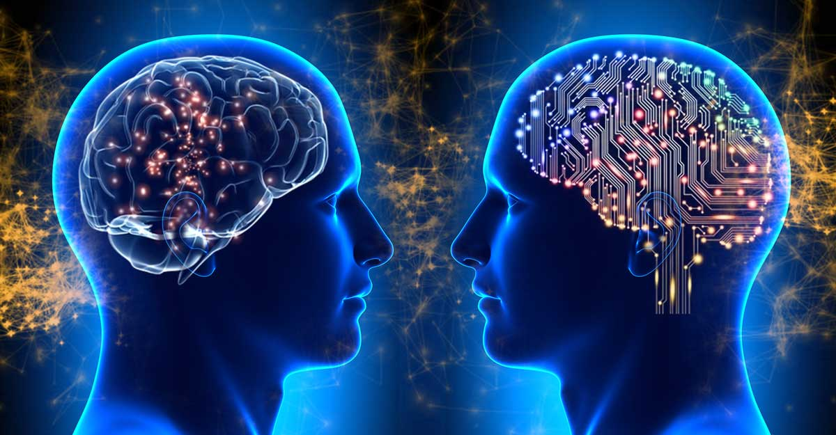
Natural Language Processing
Automates the translation process between computers and humans
Build software that will analyse, understand and generate human languages naturally communication with a computer as if it were a human

Slide 10
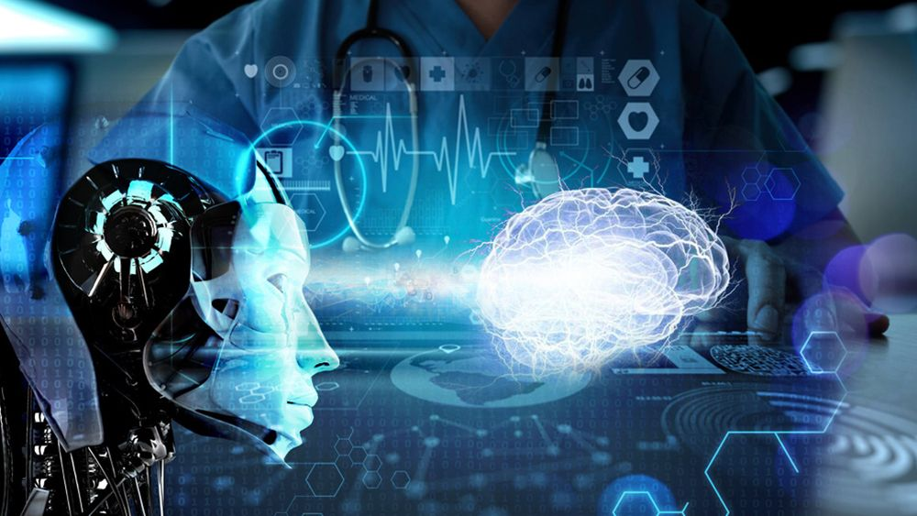
Conclusion
Provide a realistic roadmap to achieve artificial intelligence
Self-learning systems utilise machine learning models to mimic the way brain works
Creation of automated IT models capable of solving problems without human assistance

Slide 11
Thank You

